Slide 1
NOUGHTS AND CROSSES WORK
JAYDEN HOBBS

Slide 2
Contents
Success Criteria
Flowchart
Pseudocode
Final Code

Slide 3
SUCCESS CRITERIA AND REQUIREMENTS
Make game easy to understand and use
Both players to enter names
Board to show before start of game
Players to take turns 1 by 1 inputting either ‘X’ or ‘O’
Players cannot enter a nought or cross on a square that already has been inputted on
After each player has gone three times, check to see if someone has three in a row
If a player has three in row, end the game and output winners name]
If all nine squares have been filled and there is no winner, output DRAW
Keep a counter of winner's tally, finish game at certain number of games (inputted by users)
Once games have finished, ask user if they want to play again
Make the game easy to read by using time intervals between messages

Slide 4
FLOWCHART
Made using draw.io

Slide 5
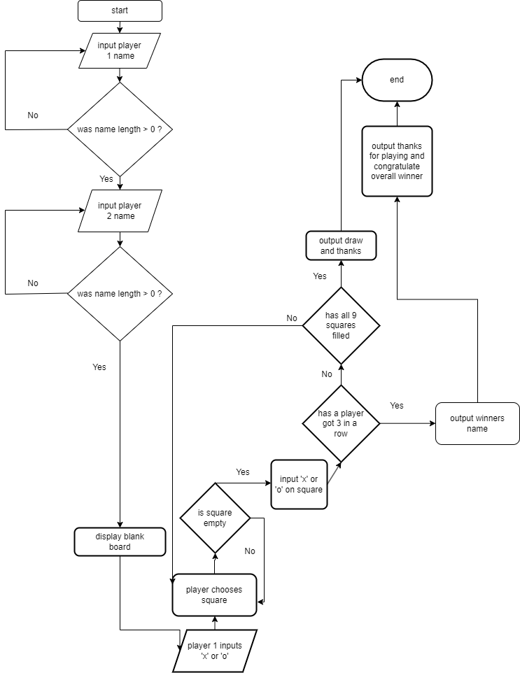

Slide 6
PSEUDOCODE

Slide 7
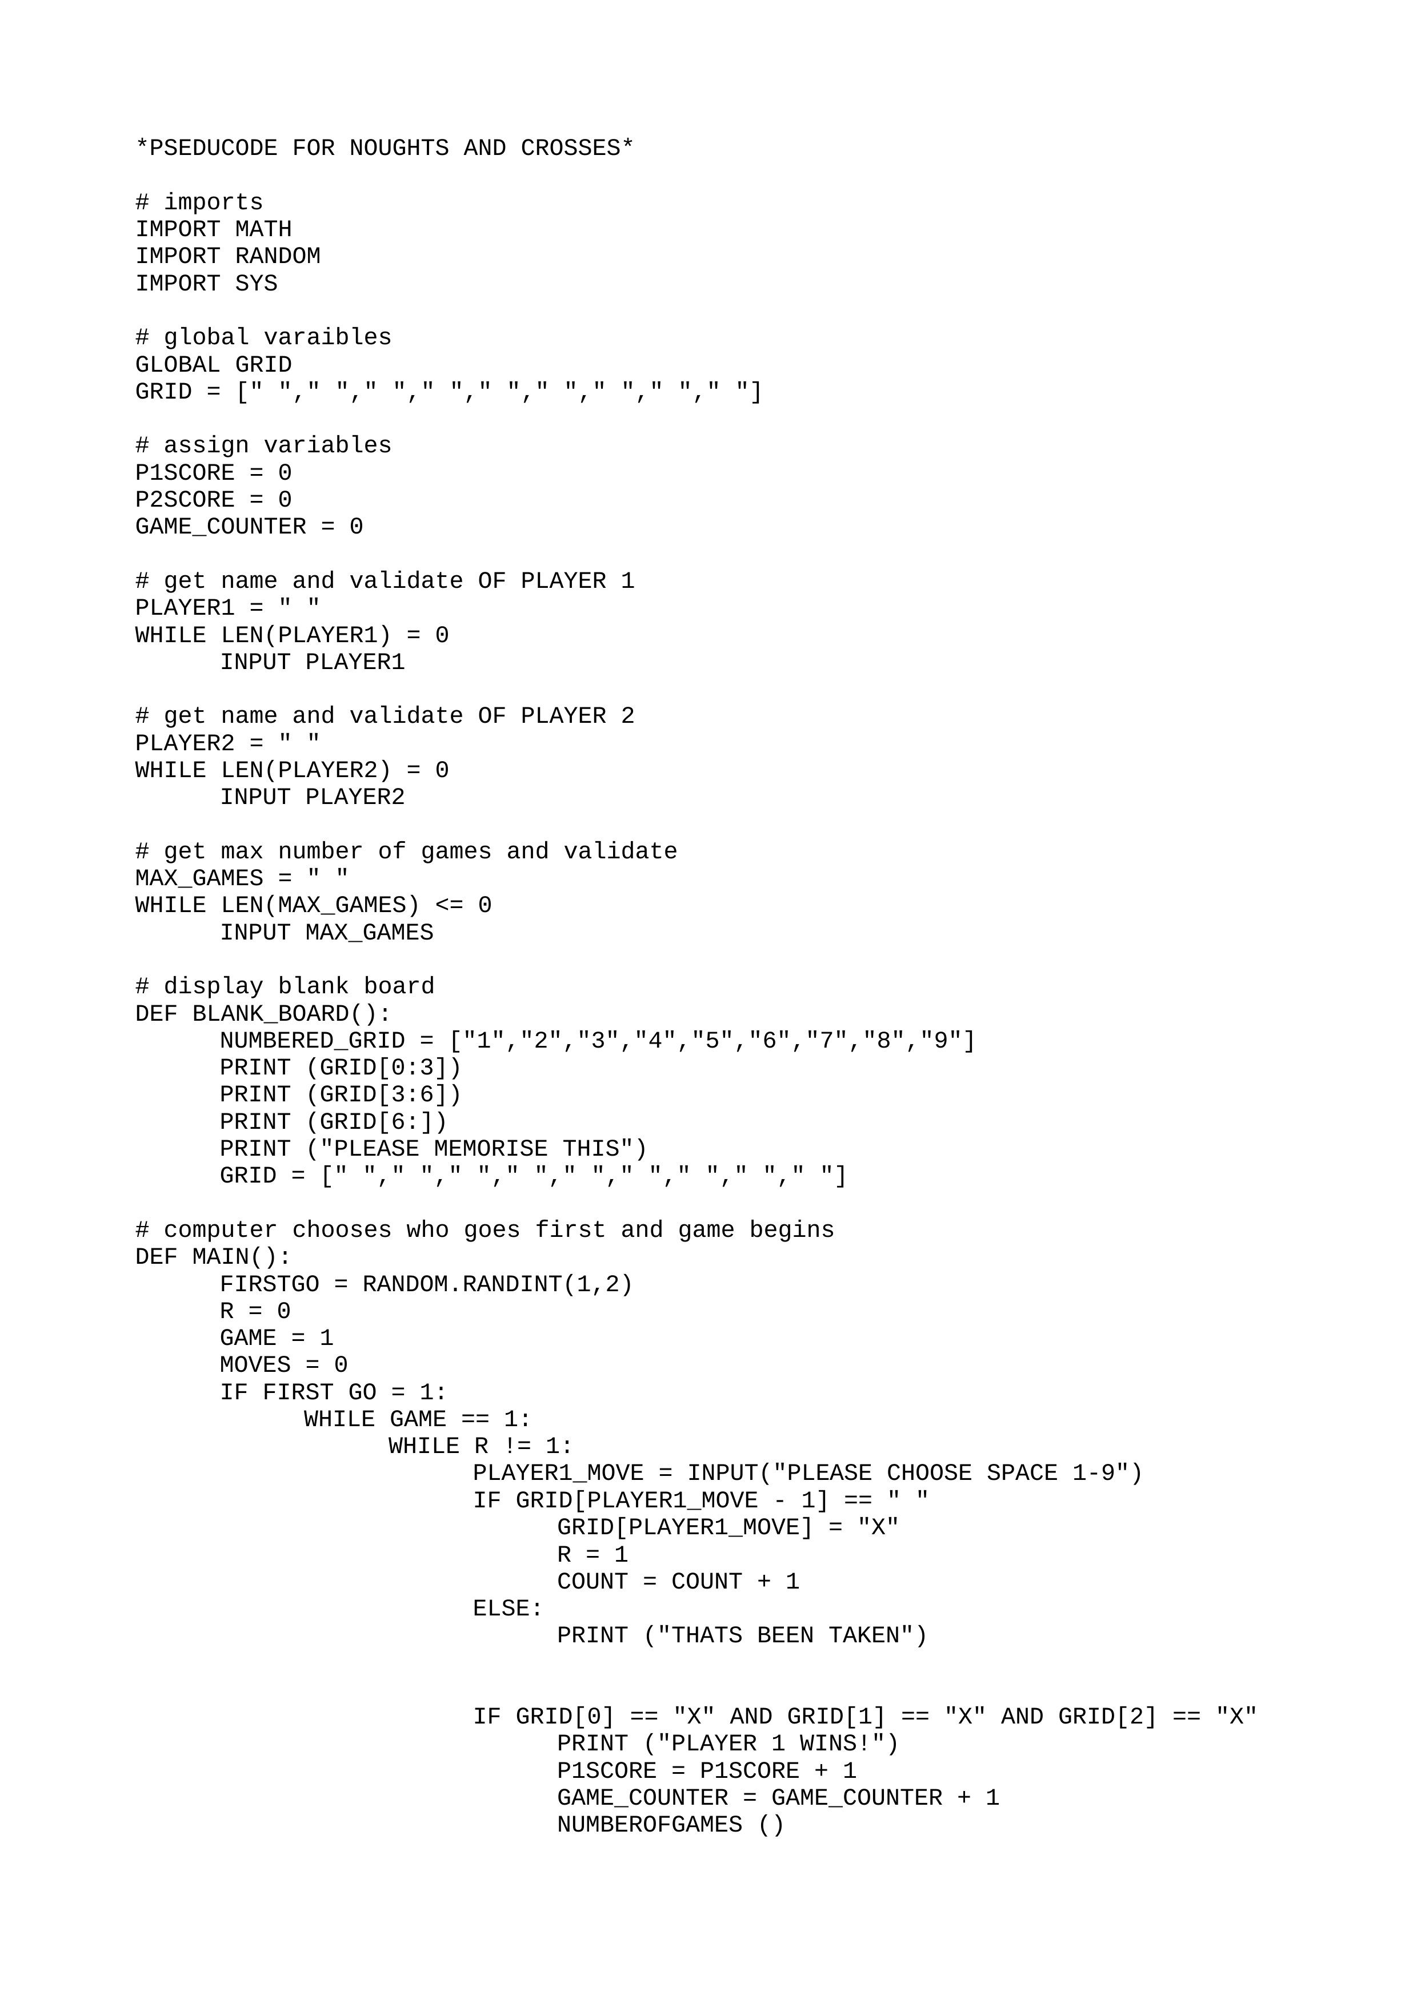

Slide 8
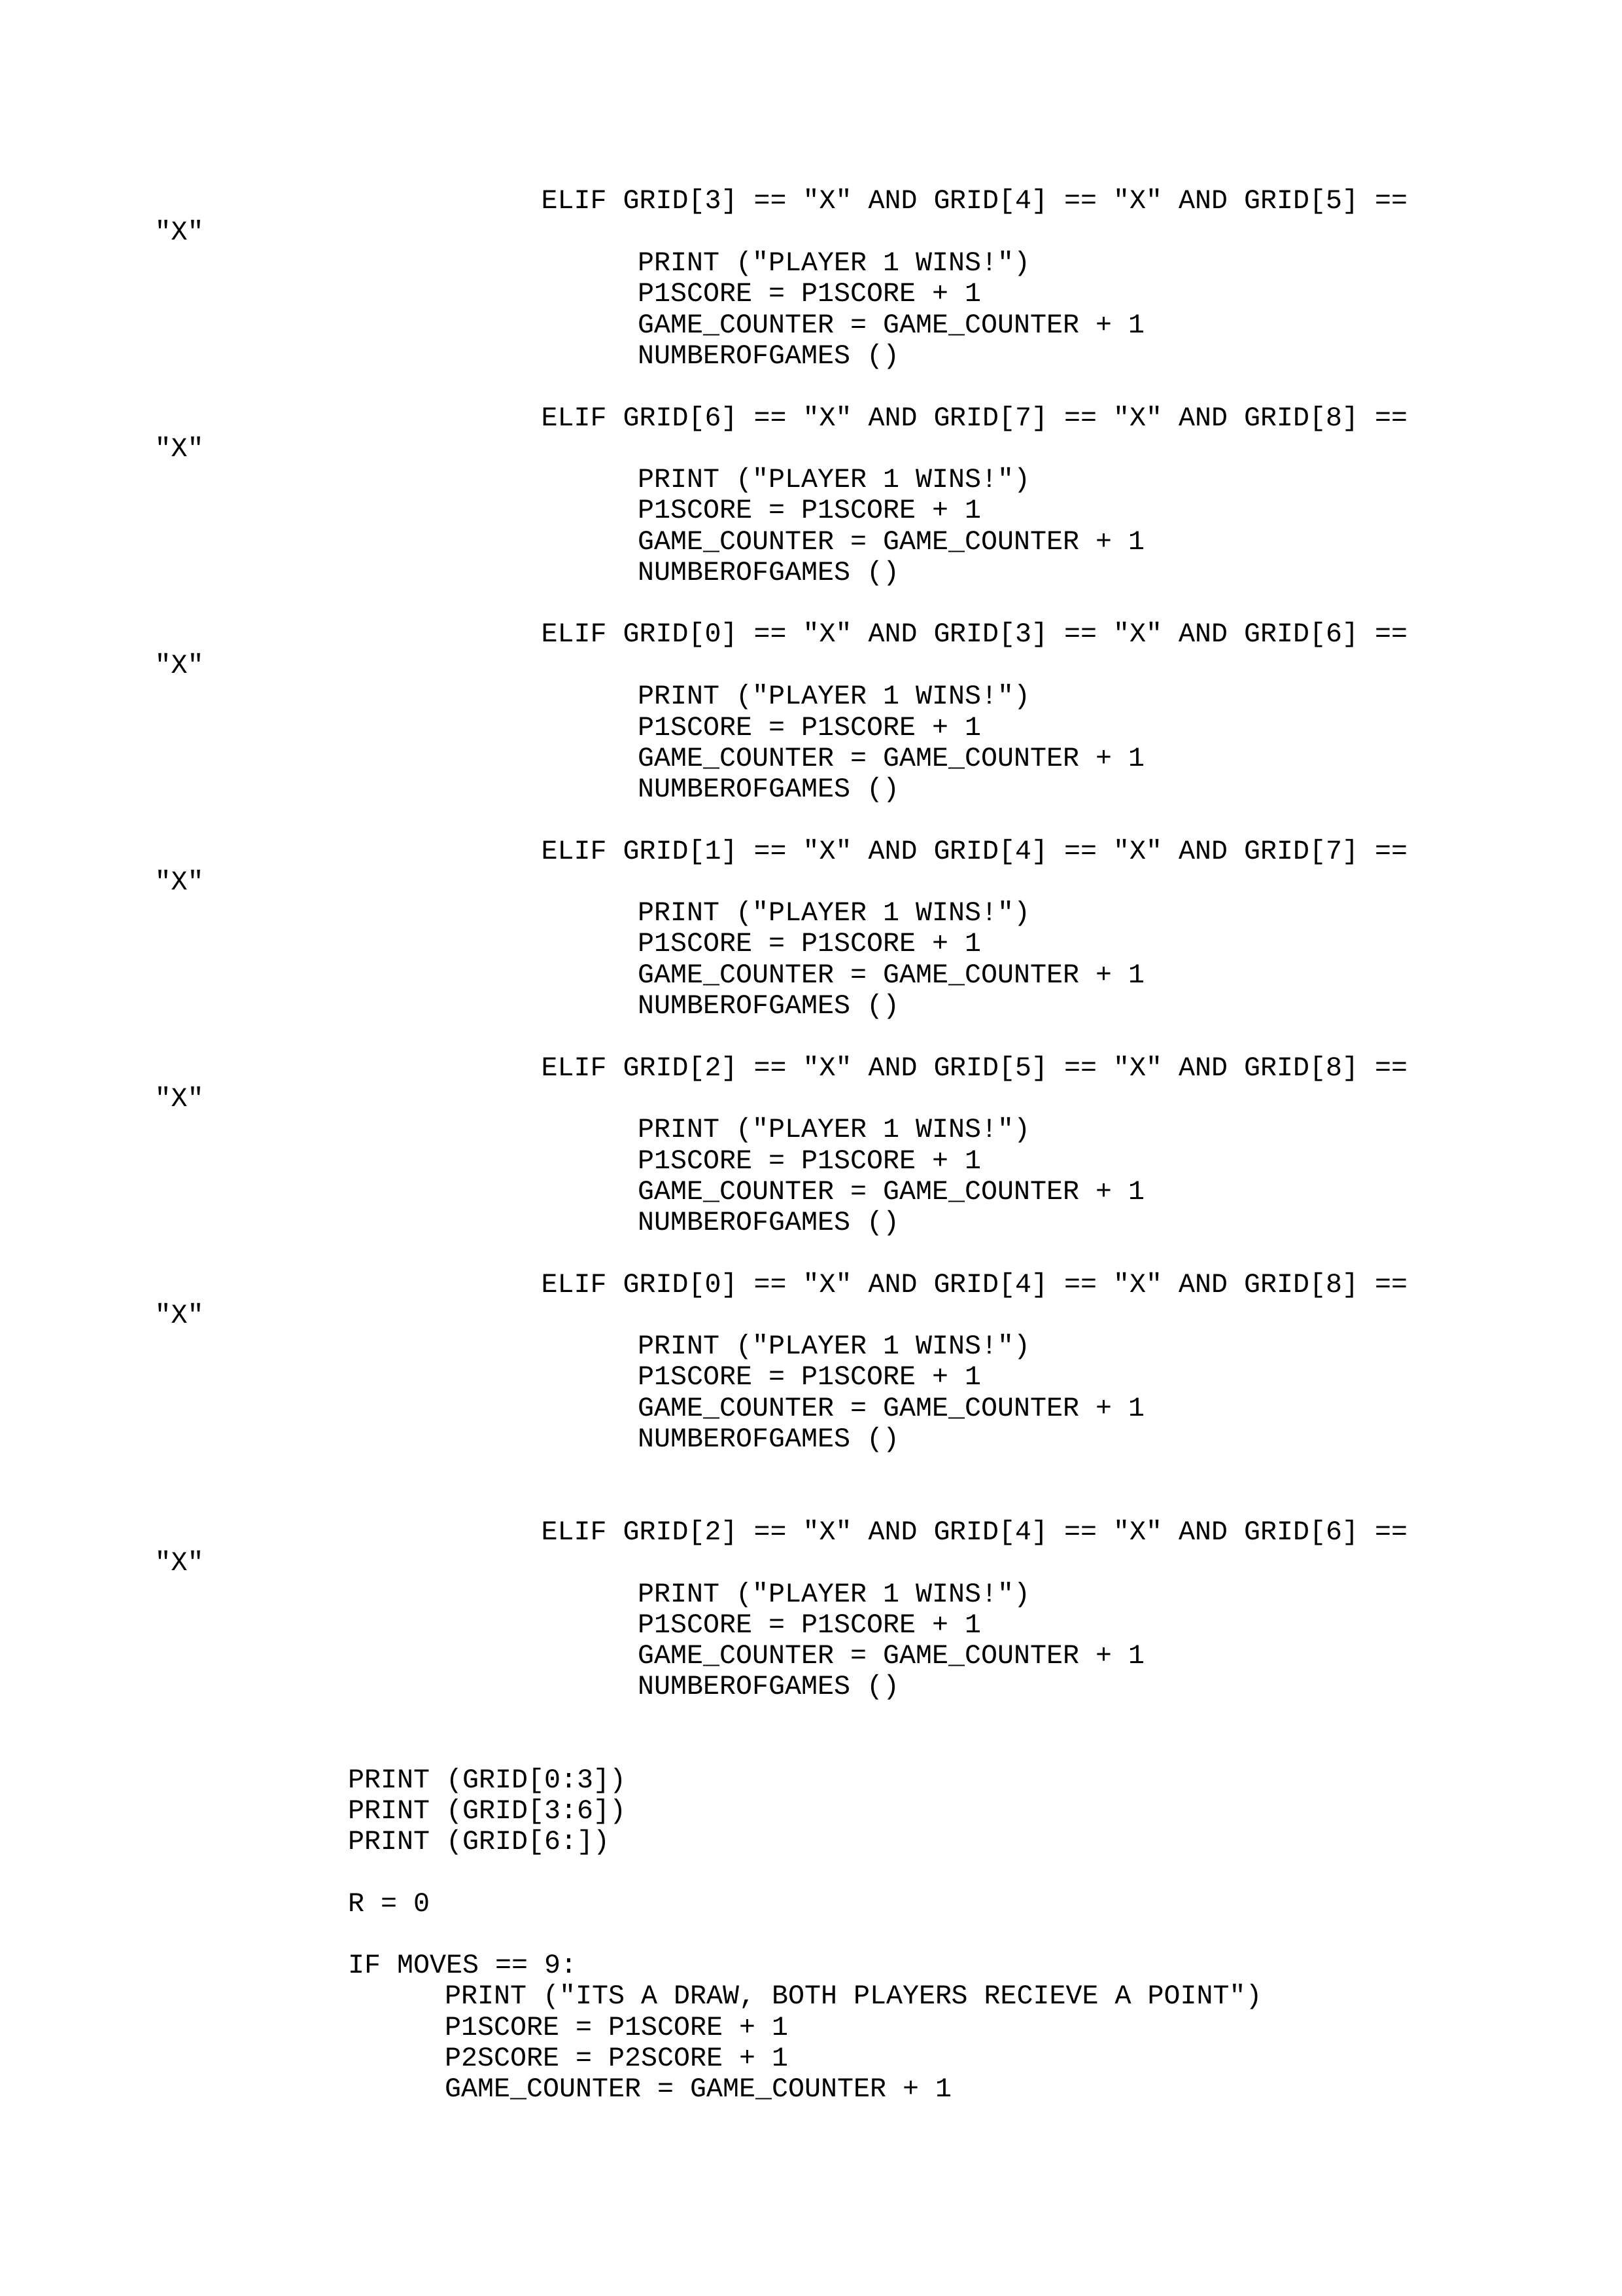

Slide 9
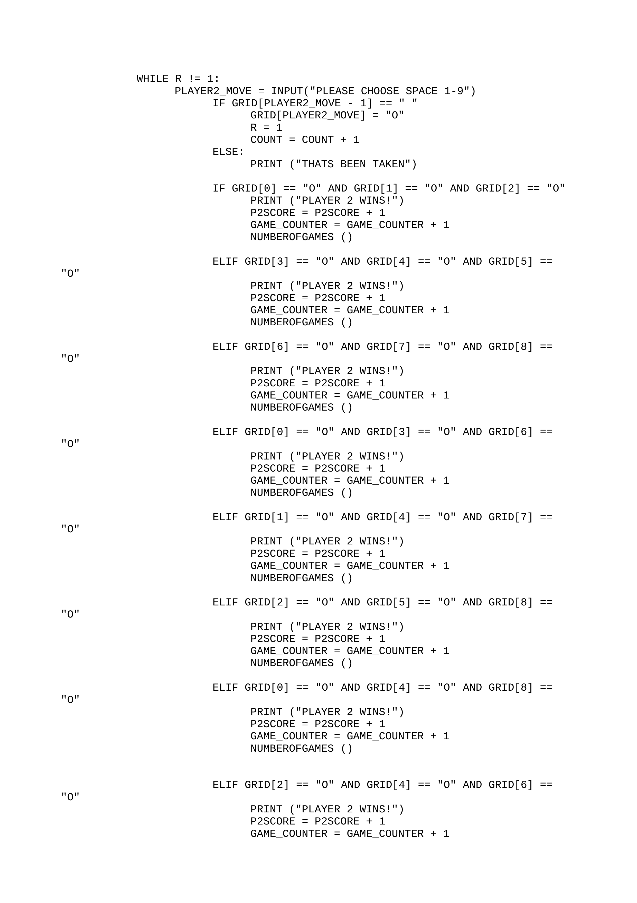

Slide 10
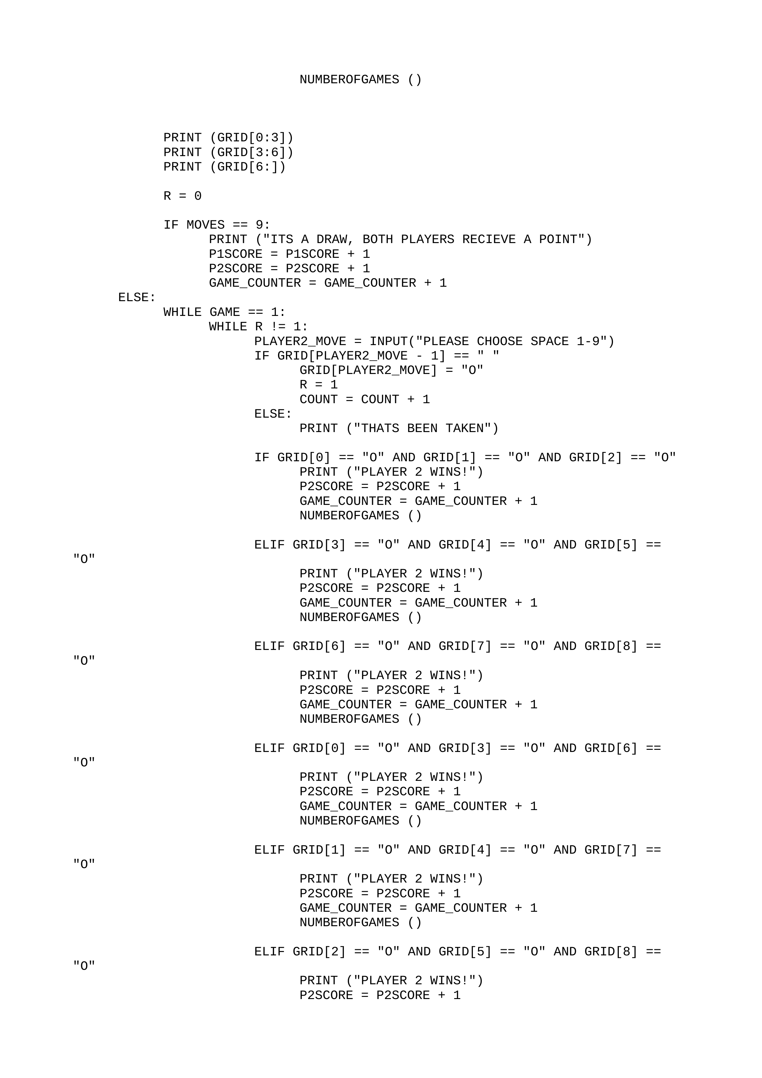

Slide 11
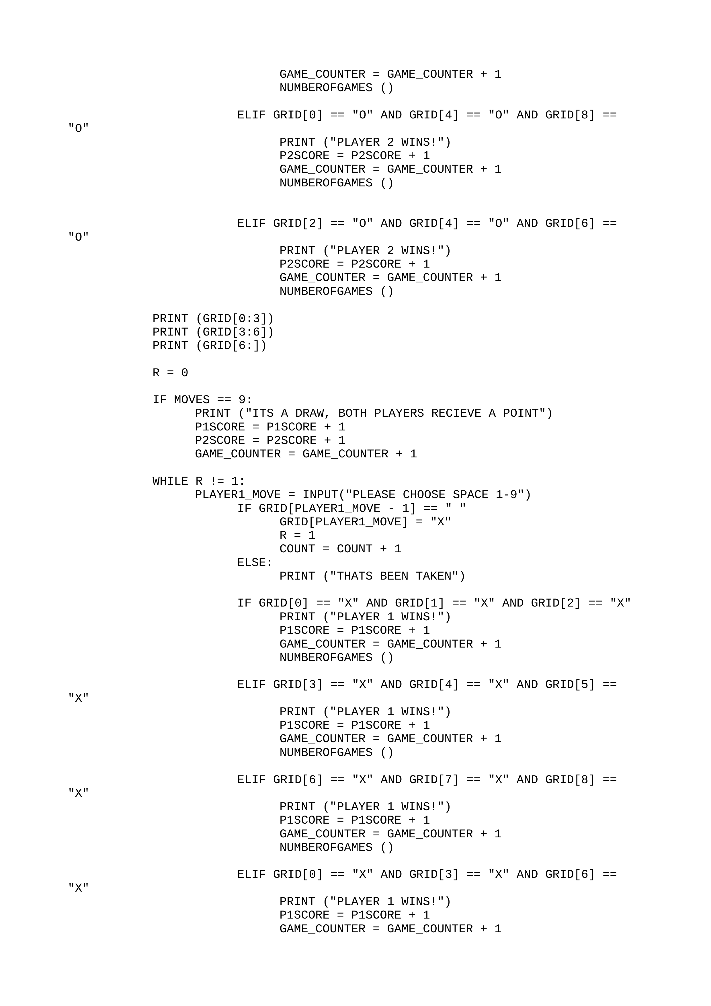

Slide 12
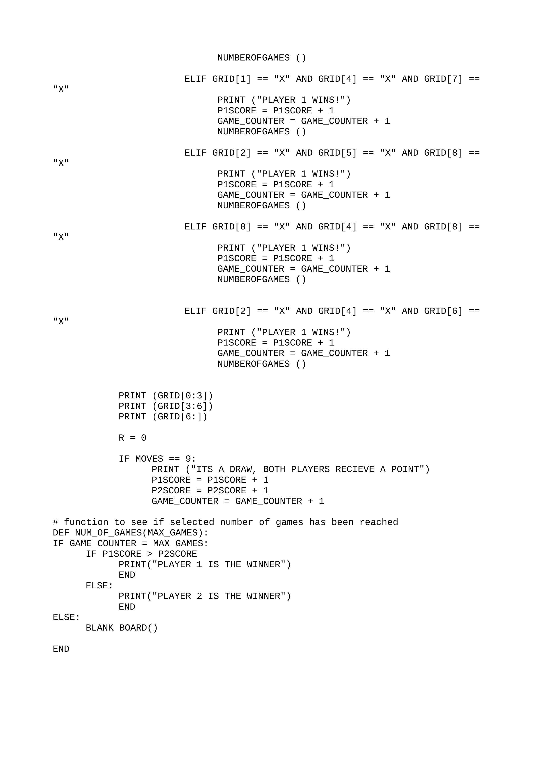

Slide 13
FINAL CODE

Slide 14
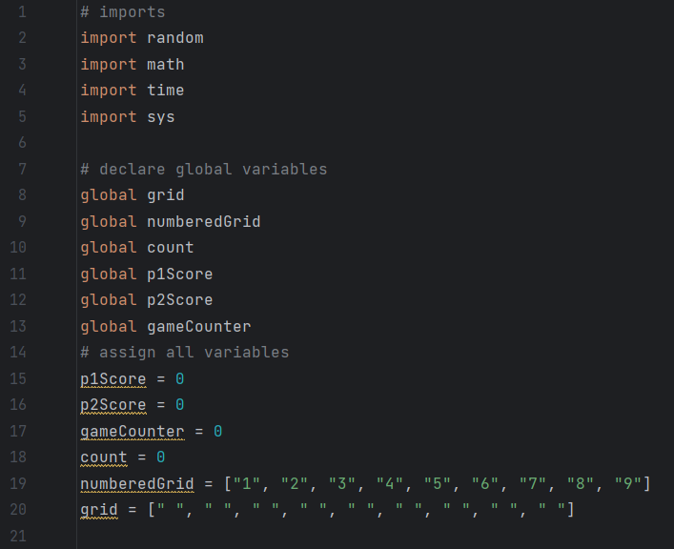
IMPORTS AND GLOBAL STATEMENTS

Slide 15
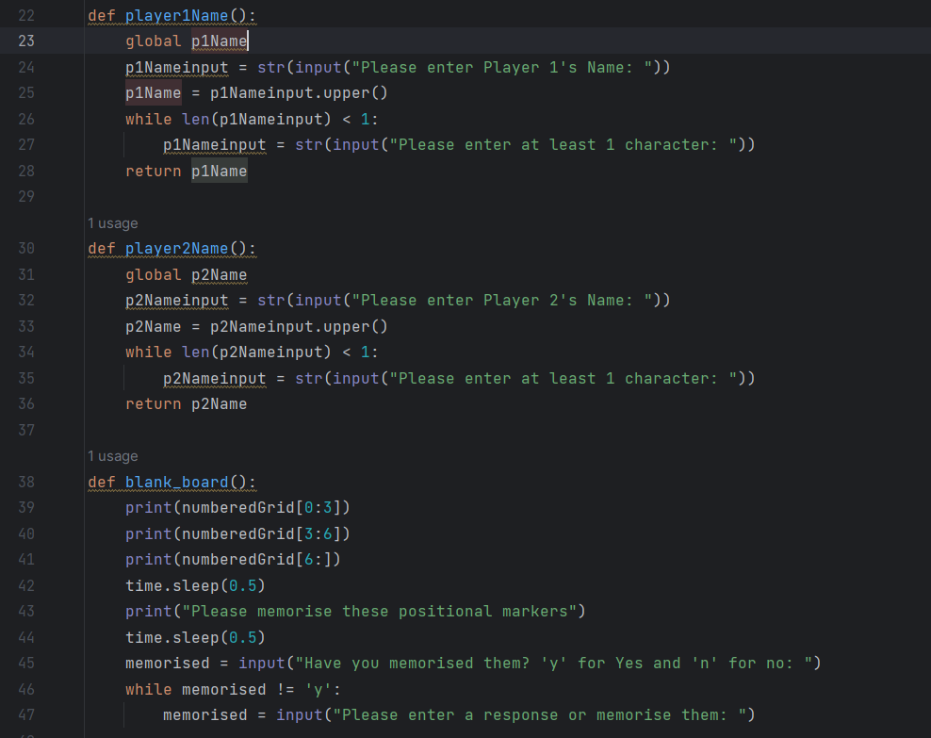
VALIDATING INPUTTED NAMES AND CREATING THE BLANK BOARD

Slide 16
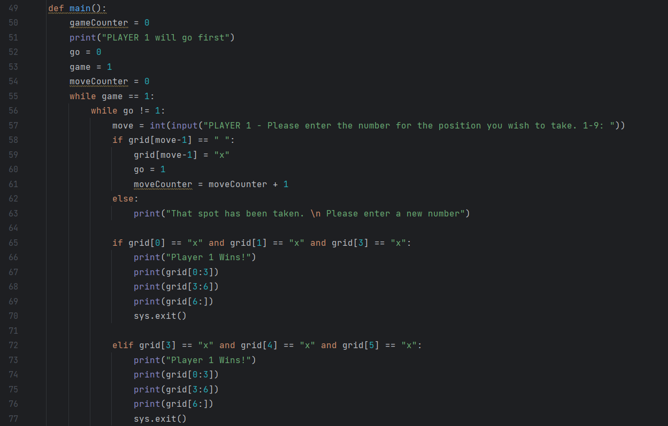
MAIN PROGRAM – PART 1

Slide 17
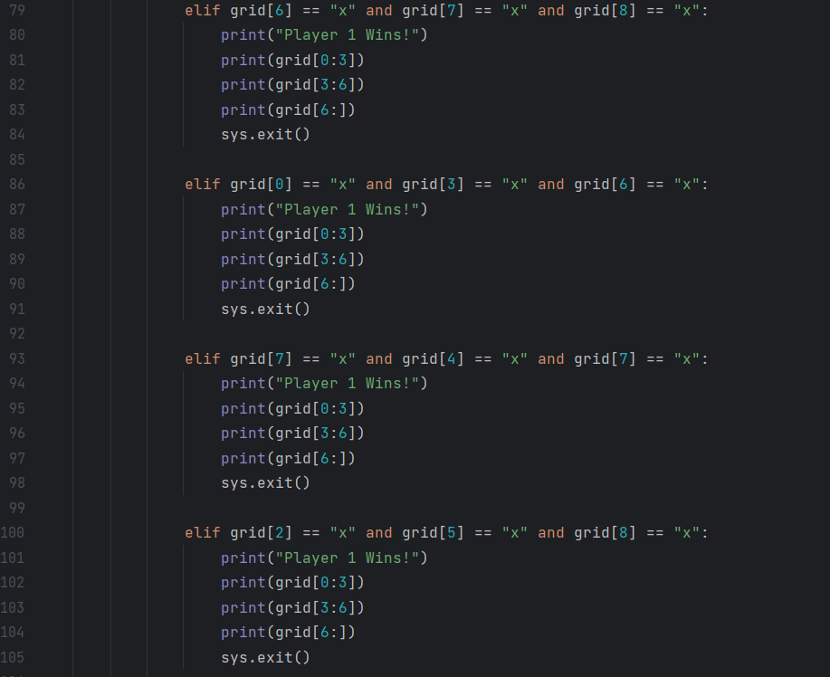
MAIN PROGRAM – PART 2

Slide 18
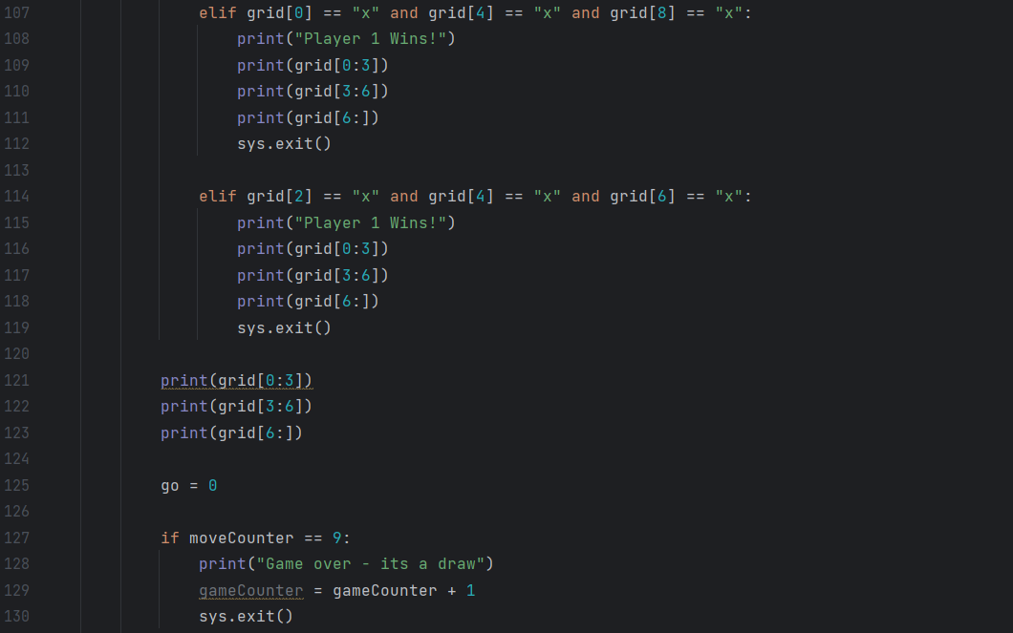
MAIN PROGRAM – PART 3

Slide 19
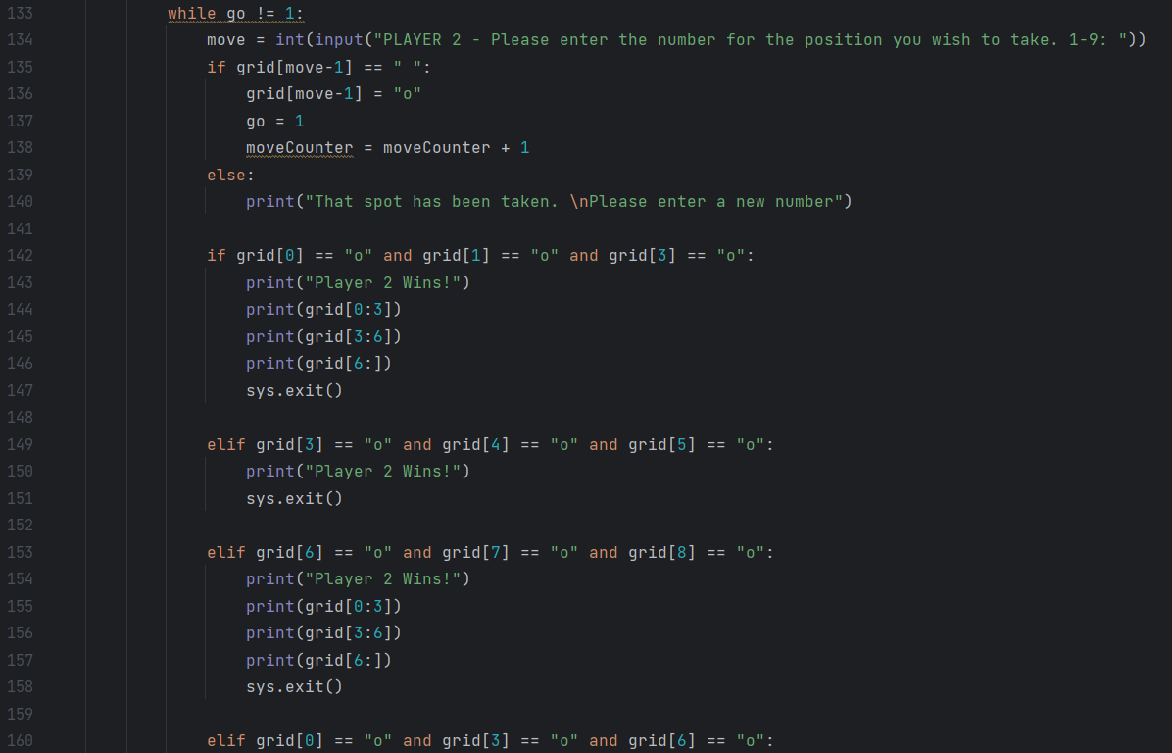
MAIN PROGRAM – PART 4

Slide 20
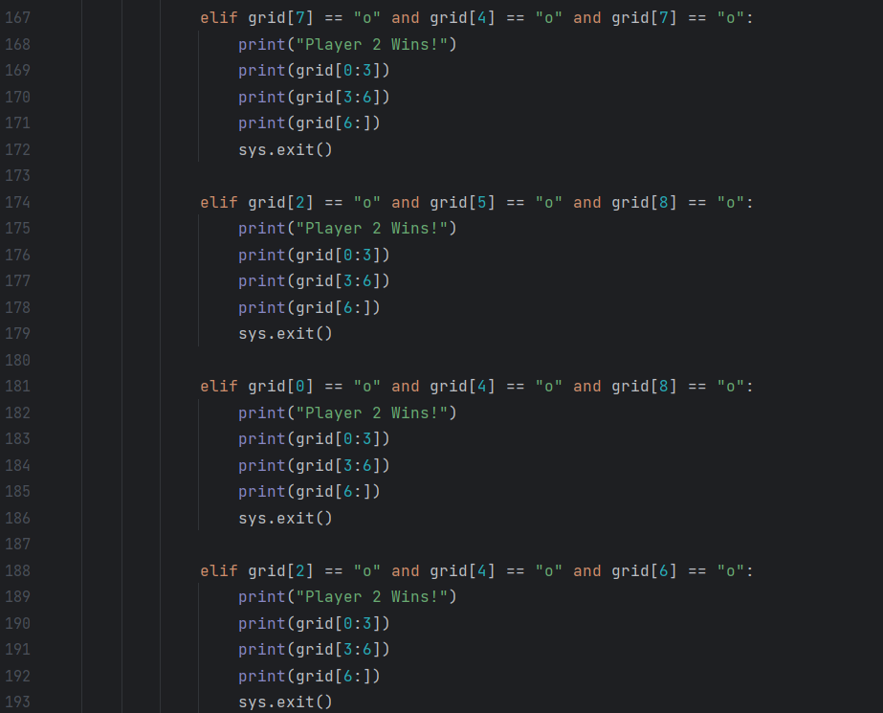
MAIN PROGRAM – PART 5

Slide 21
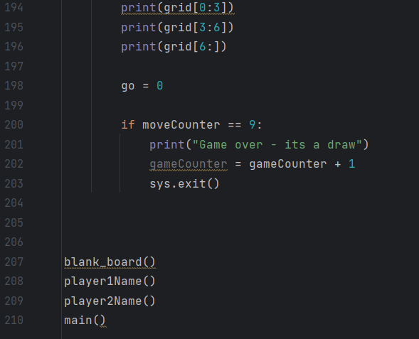
MAIN PROGRAM – PART 6

Slide 22
RESULTS
THE CODE WORKS AS WELL AS IT SHOULD!
IT ENDS SUCCESSFULLY WHEN THERE IS A DRAW AND WHEN SOMEONE WINS THE GAME
THE WAY I DID THIS PROJECT WAS BY USING A 1D ARRAY AND PRINTING IT ON THE PAGE AS THREE SEPARATE LINES TO MAKE IT LOOK LIKE A REAL BOARD. THEN USE THE INDEX OF THE ARRAY TO ENTER THE DESIRED SYMBOL

